Slide 1
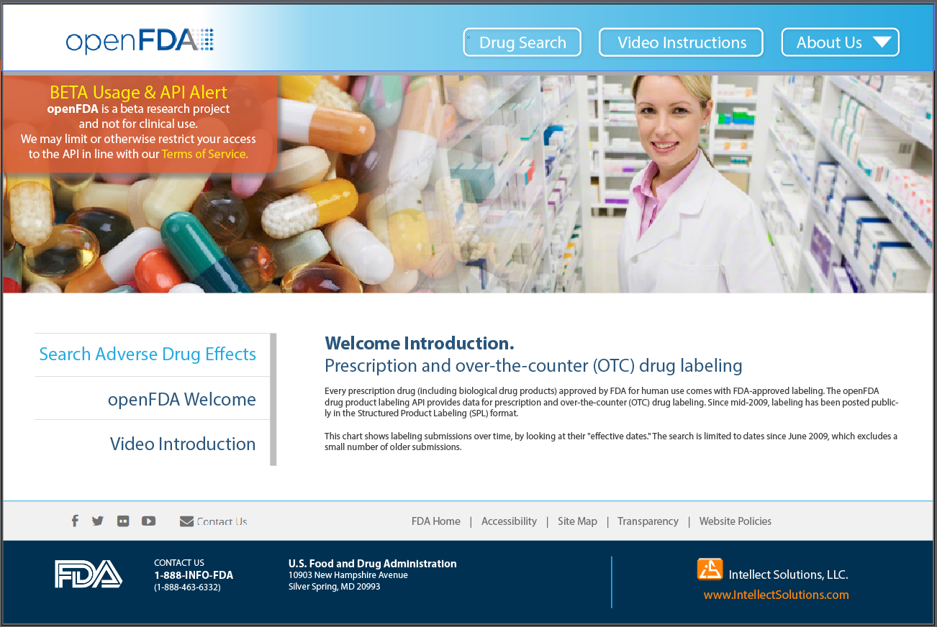
Home / landing page.
Welcome
- App description.
- API usage
- Simple instruction text
Link to Video Introduction
*Video layout in progress.

Slide 2
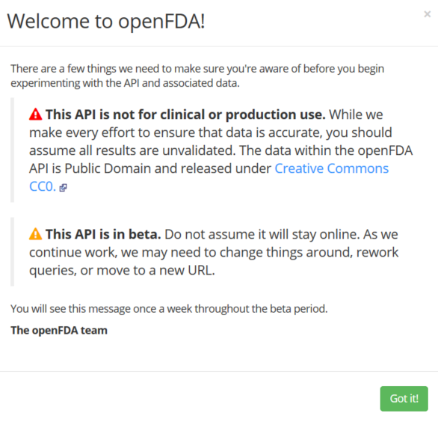
Home / landing page.
User entrance and app-logic / flow:
API warning / usage (modal).

Slide 3
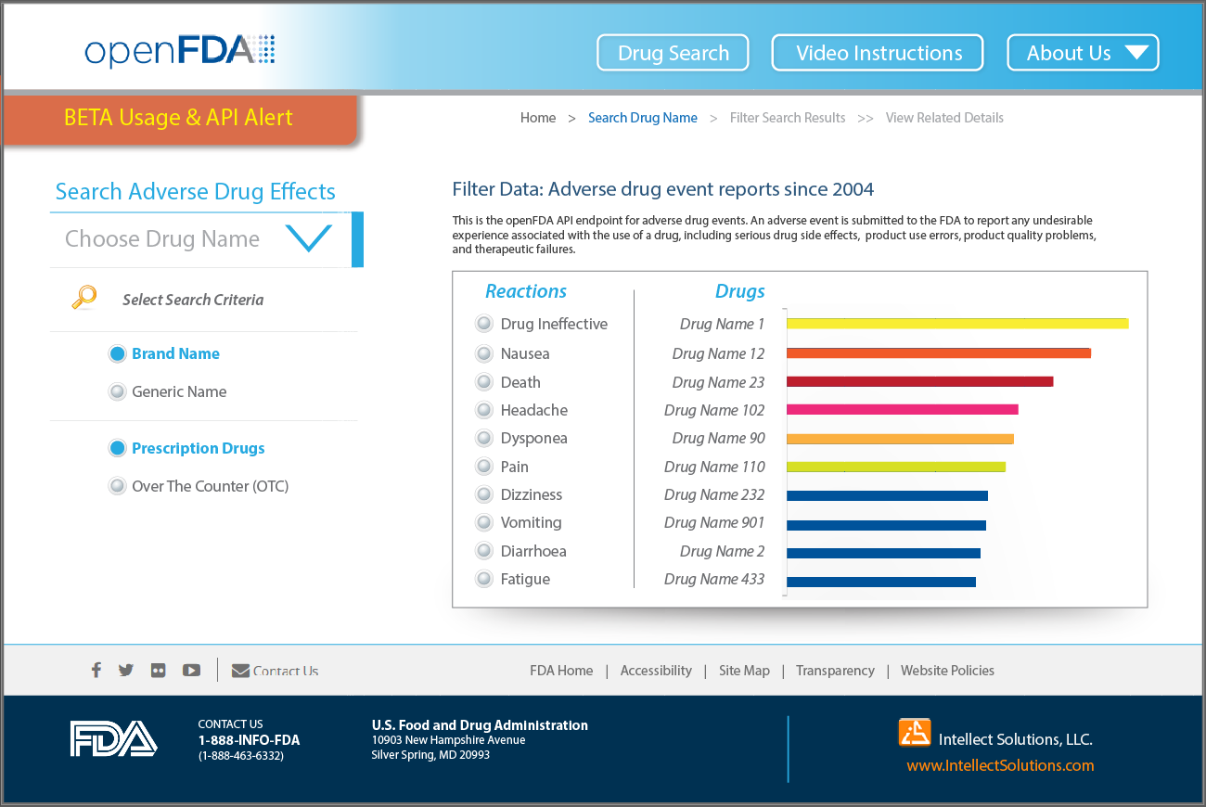
Default Entrance to Search.
- Prepopulated selections / defaults.
User Search.
User searches by Drug name
Selecting Drug Name from prepopulated drop-down menu.
Toggle Search Criteria within 2 categories.
*Preselected options to avoid blank queries.
Name: - Brand Name
- Generic Name
Type:
- OTC / over the counter
- Presecription
Search results:
1. Present Drug “Reactions” as filter-able radio-button set.
2. Present bar-graph of “Drugs” / Names.
3. *Consider placing totals as ‘mouse-over / hover’. (Touch based mobile).

Slide 4
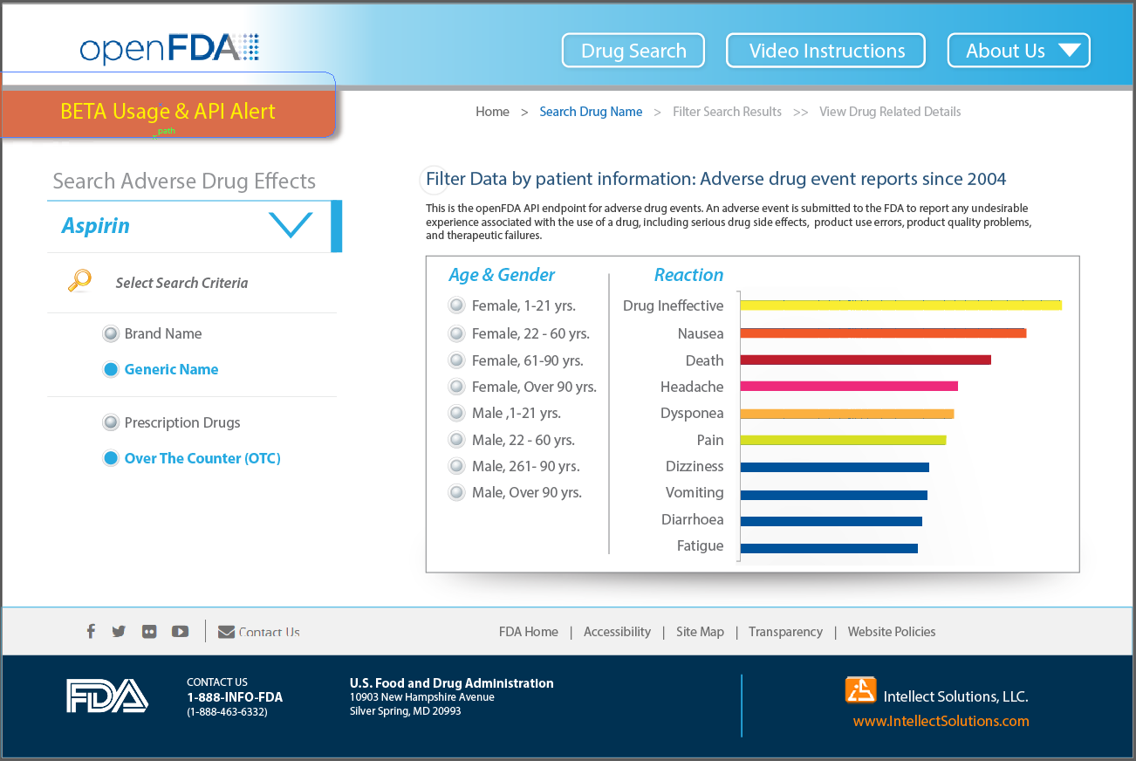
User Search Results
User searches by Drug name: ASPIRIN
Selecting Drug Name from prepopulated drop-down menu.
Toggle Search Criteria within 2 categories.
*Preselected options to avoid blank queries.
Name: - Brand Name
- Generic Name
Type:
- OTC / over the counter
- Presecription
Search results:
1. Present Patient “Age & Gender” as filter-able radio-button set.
2. Present bar-graph of Drug “Reactions”.
3. *Consider placing totals as ‘mouse-over / hover’. (Touch based mobile).

